Slide 1
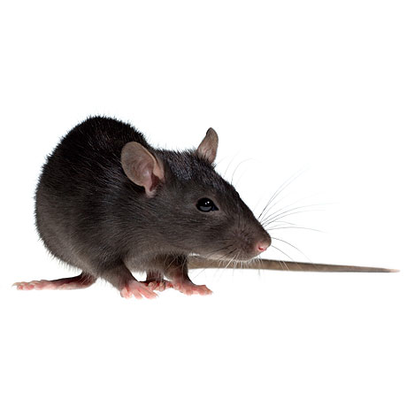


Shivering
No-shivering
Choice probability
in the normal state
Trial (#visiting the normal state)
Choice probability
in the cued state
Simulation specifications:
average over 2000 runs
algorithm: Q-learning + softmax
alpha = 0.25
beta = 5
gamma = 0.8
m = 2
n = 4
Initial internal state = 37
Optimal internal state = 37
Normal Place Temperature = 37
Cold Place Temperature = -20
Heat From Shivering = 6
Coldness Probability = 0.10
Temperature Adjustment Ratio = 0.3
Trial (#visiting the cued state)
Choice probability
in the cold state
Trial (#visiting the cold state)
Internal temperature
(arbitrary unit)
Trial (#visiting any state)
Internal temperature
(arbitrary unit)
Trial (#visiting any state)
Trial (#visiting any state)

